Slide 1
A tale of two enrichments
C. Titus brown
Microbial diversity 2016

Slide 2
Stated goal
Isolate sulfur-oxidizing denitrifiers from the environment and examine for metabolic diversity, esp in comparison to S. denitrificans.

Slide 3
Base media design (modification of Sievert S. denitrificans media)
”BB” anaerobic media (”brackish base”) – per liter H₂O,
10.5g NaCl
1.7g MgCl₂-6H₂0
0.125g CaCl₂-2H₂0
0.5g KCl
After autoclaving, cool with N₂ and then add:
Bicarb buffer (5g NaHCO₃ + 0.5g KH₂P0₄ in 50 ml)
1ml of 1000x trace metal solution (Jared’s Special Sauce)

Slide 4
Base media design (“CENPS” considerations)
”BB” anaerobic media (”brackish base”) – per liter H₂O,
10.5g NaCl
1.7g MgCl₂-6H₂0
0.125g CaCl₂-2H₂0
0.5g KCl
After autoclaving, cool with N₂ and then add:
Bicarb buffer (5g NaHCO₃ + 0.5g KH₂P0₄ in 50 ml)
1ml of 1000x trace metal solution (Jared’s Special Sauce)

Slide 5
Initial energy sources for selection for autotrophs:
10mM thiosulfate => sulfur oxidation, electron donor
20mM potassium nitrate => nitrate reduction, electron acceptor

Slide 6
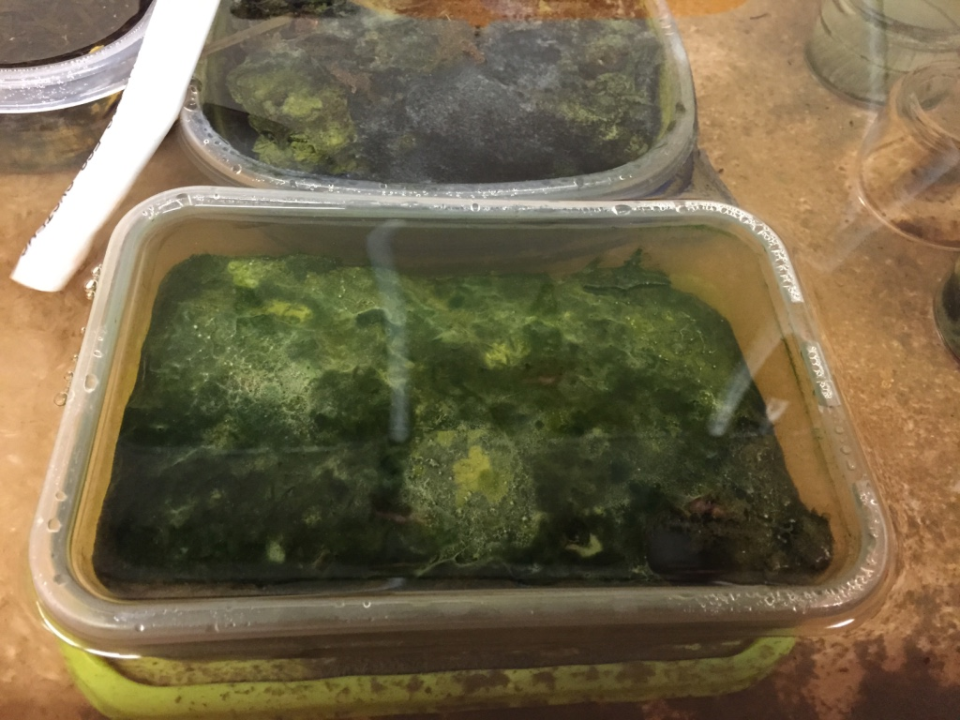
Enrichments! Growth!
Sample 4: Trunk River sediment.
Sample 8: Sea table enrichment,
originally from Trunk River.

Slide 7
First round transfers: no growth ☹. (In which Jared provides both the problem and a solution.)
Hypothesis: initial transfer of material (“really ladle it in there, son!”) brought in organic material that, combined with high thiosulfate/nitrate molarity, led to rapid growth.
Observation: vinegar smell, indicative of decomposing acetate.
Proposal: “perhaps you will get growth if you spike in acetate”

Slide 8
Result: acetate-dependent growth! (Heterotrophs are better than nothing, I guess.)
Addition of 10 mM NaOAc to first-stage transfers led to rapid growth (14-20 hrs to opacity, at 30 deg).
Two successive transfers (1ml into ~40ml) into BB+NSA (BB+nitrate/thiosulfate/acetate) also grew.
Yay!
What do they require?

Slide 9
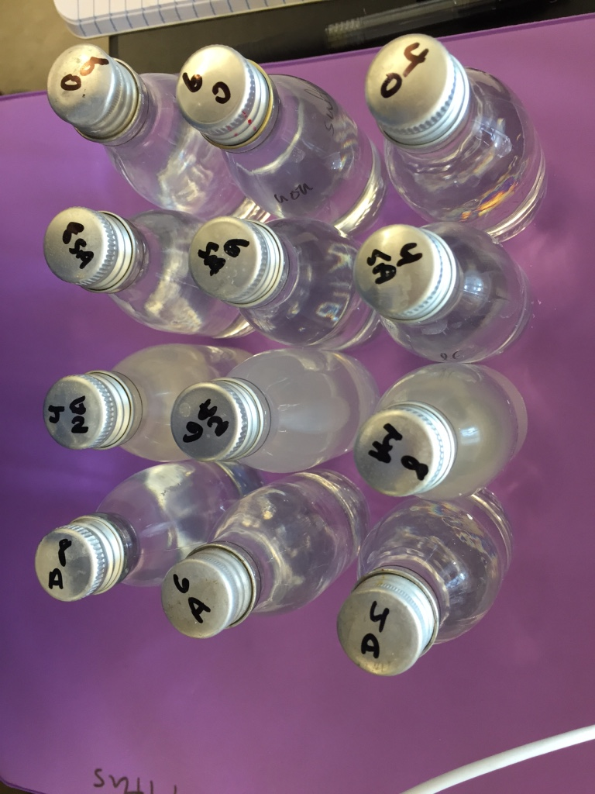
Differential diagnosis: What do these enrichments eat?
Try:
No energy source (0)
Thiosulfate and acetate (SA)
Nitrate and acetate (NA)
Acetate alone (A)
Strong prior that 0 and A would not grow.
Result: nitrate and acetate are both necessary and sufficient for growth in BB media.

Slide 10
Next step: can we isolate? I now have nitrate-dependent heterotrophs, not sulfur-oxidizing autotrophs. Oh well. Something’s growing! Onward!
Questions:
Can we grow colonies on solid media, anaerobically or aerobically?
Can we “pull a Dianne” and grow this aerobically on LB and then transfer back to anaerobic BB+(nitrate/acetate) media, etc?

Slide 11
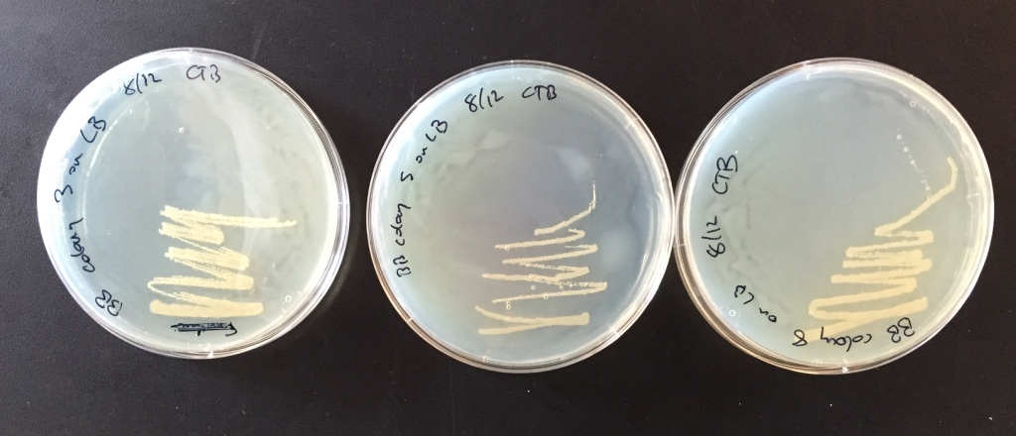
Next step: can we isolate?
Questions:
Can we grow colonies on solid media, anaerobically or aerobically?
YES!
Can we “pull a Dianne” and grow this aerobically on LB and then transfer back to anaerobic BB+(nitrate/acetate) media, etc?
YES!!!
BB liquid (enrichment x 4) ->
LB plate (colonies) ->
BB liquid (from single colony) ->
LB plate

Slide 12
Next step: can we isolate?
Questions:
Can we grow colonies on solid media, anaerobically or aerobically?
YES!
Can we “pull a Dianne” and grow this aerobically on LB and then transfer back to anaerobic BB+(nitrate/acetate) media, etc?
YES!!!
BB liquid (enrichment) ->
LB plate (colonies) ->
BB liquid (from single colony) ->
LB plate
Isolates: 16-4-MP-CTB-34, 36, and 38

Slide 13
The story so far:
I have 3 isolates (all originally from Trunk River) that exhibit rapid nitrate and acetate dependent anaerobic growth in brackish media (BB) at 30 deg.
Each of these isolates also grows aerobically on LB plates at 30 deg (in total, 7/8 of LB colonies grew when transferred back to BB+NA).
Questions!
What are they taxonomically?
What do they look like?
What can we discover about their metabolism?

Slide 14
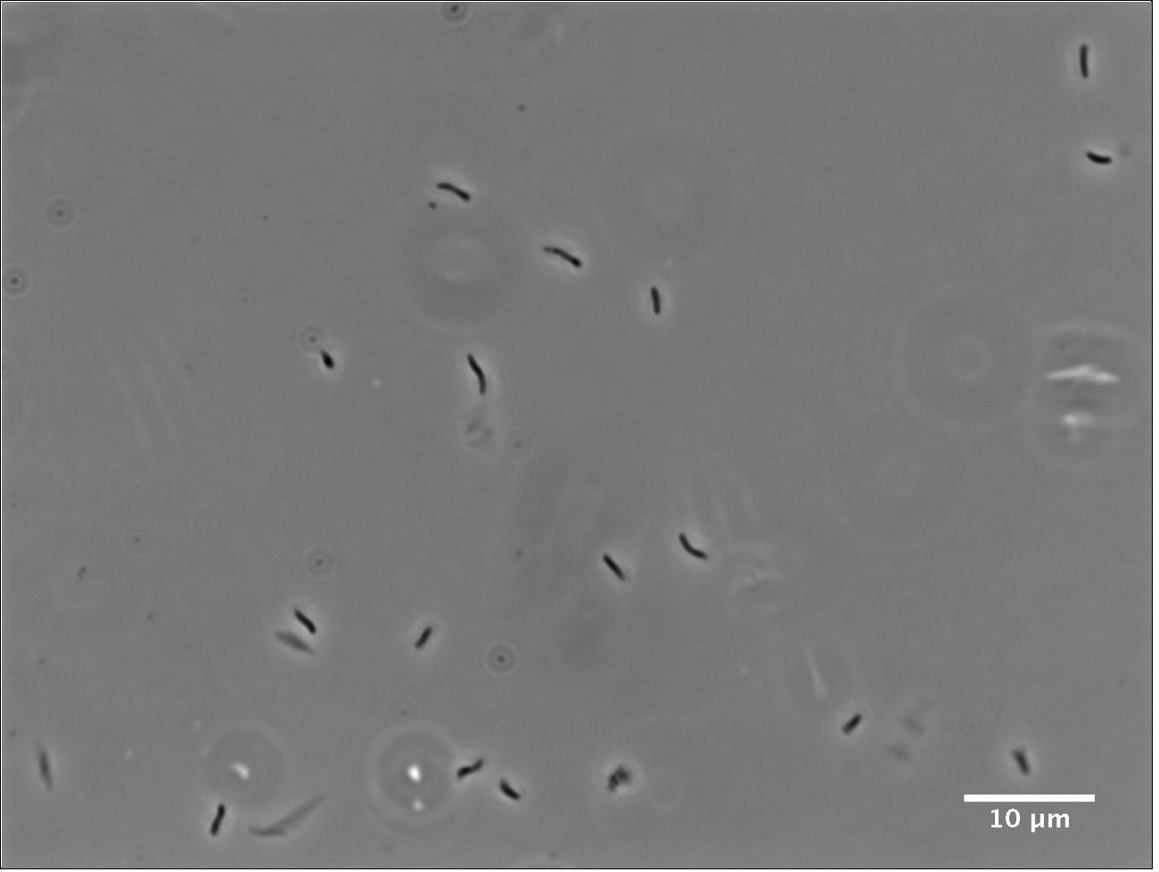
What do they look like?

Slide 15
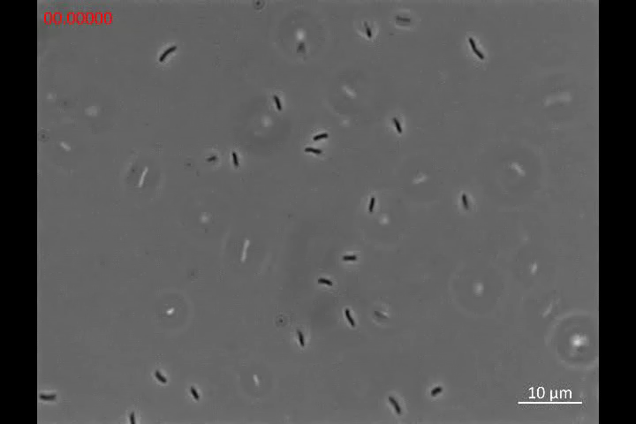
Video!

Slide 16
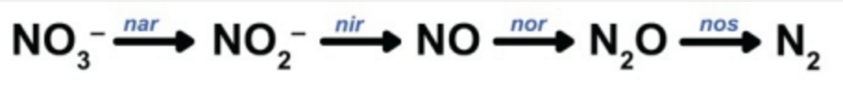
Metabolism: outputs
In anaerobic BB+NSA cultures, I observed super-saturated gas (“champagne” effect).
Mass spec shows presence of N₂0 in isolate cultures – 10-20 nM range.
Suggests canonical denitrification pathway at work:
GC shows only trace methane (< 1%)
No identified peaks in HPLC.
IC results still under analysis.

Slide 17
What are they, taxonomically?
According to 16s sequencing, the isolates are
______________ ___________.
(Blanks hopefully to be filled in on Monday.)

Slide 18
Next steps
Further work on isolates:
Growth curves, metabolite analysis, stoichiometric examination.
Given fast aerobic growth, I suspect they are already a well known genus/species.
These seem like pretty ideal “lab bugs”!
Lots of “weird and interesting” from enrichments.
A third enrichment grew more slowly in same conditions (~24-30 hrs to opacity) and exhibited different morphology (cocci). Proceed to isolation?
I’d like to re-examine growth and behavior in thiosulfate + nitrate & acetate; different color floccule, crystallization on plate.

Slide 19
Actual goal achieved
Isolate sulfur-oxidizing denitrifiers from the environment and examine for metabolic diversity, esp in comparison to S. denitrificans.
Grow and isolate something!
(Also: learn some basic environmental biogeochemistry; work with biosensors; learn to blend in with microbiologists.)

Slide 20
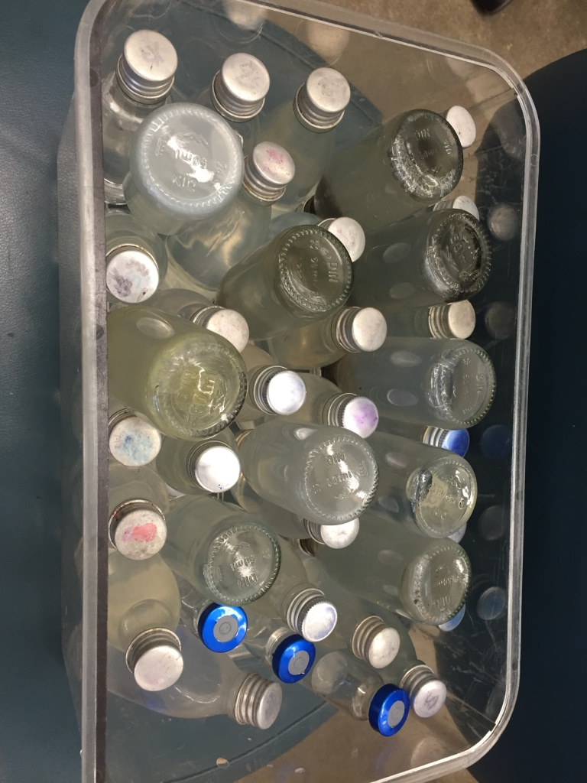
Thank you!
Isolates: 16-4-MP-CTB-(32 to 38)
All the instructors and TAs have been wonderful!
Jared & Dianne for letting me come!
The Moore Foundation for paying my travel, tuition, room, and board!
The awesome students!!!!
Please come visit me in Davis - welcome any time to work on bioinformatics & genomics!
I also run lots of bioinformatics workshops – come! Google ‘dib-training’ or ask me or anyone in the group.

